Slide 1



Resource Pack
Medical Services
Developed for World War One Centenary: Continuations and Beginnings by Richard Marshall, University of Oxford (August 2012). Free, high quality educational resources on new perspectives of the First World War. http://ww1centenary.oucs.ox.ac.uk.

Slide 2
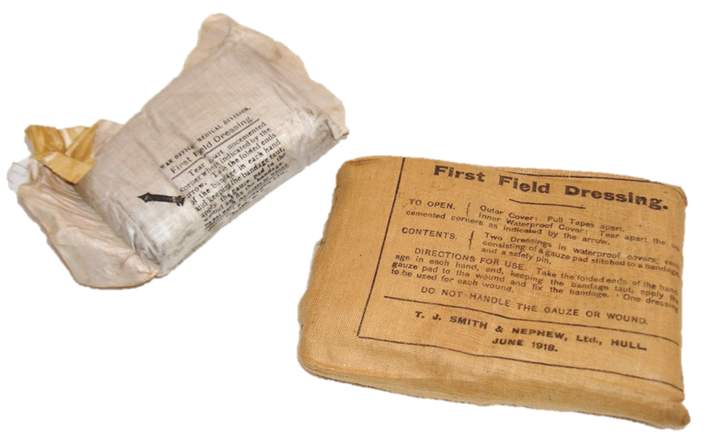
First Field Dressing. Marshall collection, available via World War One Centenary OER Project as CC BY-NC-SA
Issued to every man in the British army, the First Field Dressing was carried in a special pocket in the skirt of the Service Dress Jacket. Each cloth packet contained two dressings (for entry and exit wounds) and provided instructions for use (unopened packet on right, individual dressing in waterproof cover on left). These dressings were intended to be applied by the wounded man himself or his comrades, and in most cases were the first line of treatment available at the front. From 1916, an ampoule of iodine (a disinfectant) was also issued with the Field Dressing. No other first aid equipment, and no means of pain relied, was issued to the individual soldier.

Slide 3
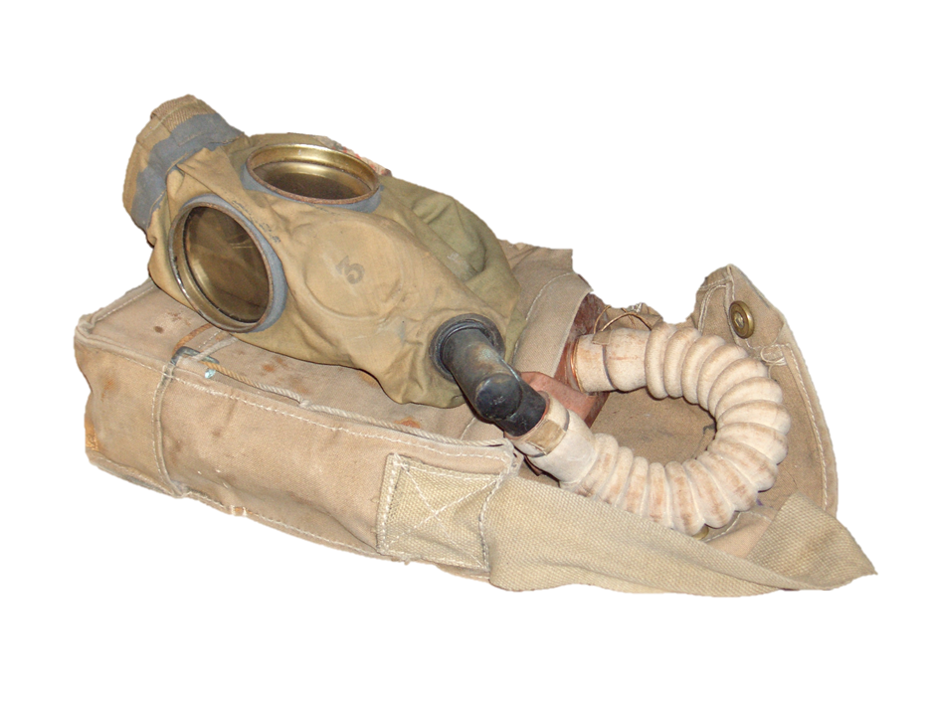
British Small Box Respirator. Marshall collection, available via World War One Centenary OER Project as CC BY-NC-SA
Introduced in late 1916, the Small Box Respirator replaced the cumbrous gas helmets (cloth bags soaked in chemicals and worn over the head) and provided much better protection against a range of poisonous gasses. A nose-clip forced the wearer to breath through the mouth via a tube connected with the filter. The filter remained in a canvas bag worn on the chest. As the war progressed, the composition of the filter was altered to combat the latest chemical agents employed by the enemy. Also adopted in slightly modified form by American troops.

Slide 4
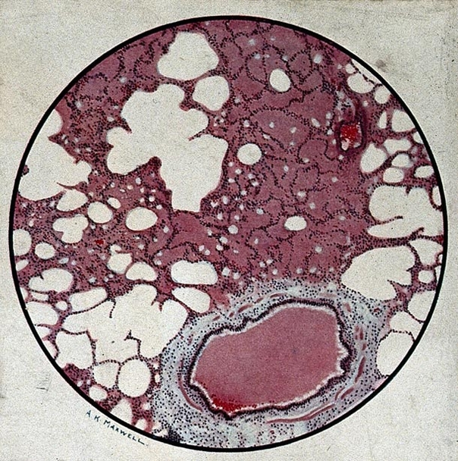
Microscopic section of human lung from phosgene shell poisoning: death at 19th hour after gassing, c.1917. Available via Wellcome Collection as CC-BY-NC-SA
This rare illustration shows the pathological damage caused by phosgene. This gas proved to be even more dangerous than its forerunner - chlorine - as it induced much less coughing and consequently more of it was inhaled. It also had a delayed effect, so that apparently healthy soldiers could succumb to poisoning up to 48 hours after inhalation. As with other poison gases, phosgene attacked the respiratory system and resulted in suffocation.

Slide 5
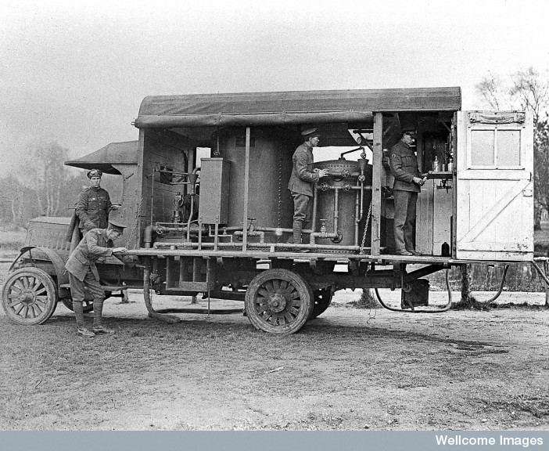
Water Chlorination Lorry. Available via Wellcome Collection as CC-BY-NC-SA
Lorry with water purification apparatus. Provision of clean drinking water for the large number of troops (not to mention horses) concentrated in a small area of northern France was a major challenge, only exacerbated as the ground became poisoned by effluent, corpses, and gas. An especial problem was keeping water supplied to the front during advances: as the troops moved across the devastated zone water had to be physically carried to them, and provision made for the laying of pipes that might soon be cut by gunfire. Uniform details suggest date of 1918.

Slide 6
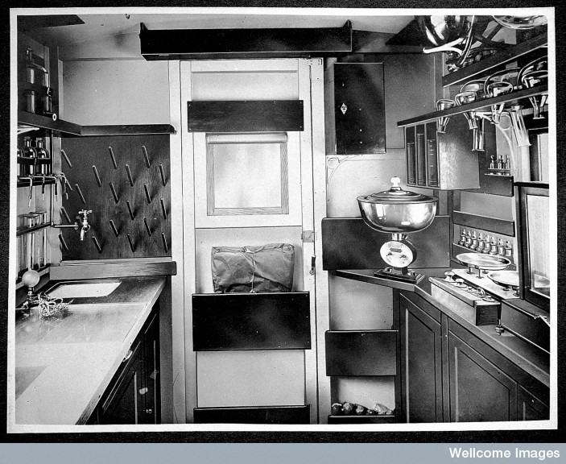
Mobile bacteriological laboratory. Available via Wellcome Collection as CC-BY-NC-SA
Interior of a mobile bacteriological laboratory mounted on the back of a lorry, presented by HRH Princess Christian for the use of the army medical service in France.
Such facilities provided doctors working behind the front with the facilities to diagnose illnesses quickly and accurately, allowing timely, targeted intervention and so a greater chance of successful treatment. The ability to undertake detailed laboratory study in France lead to the initial isolation and identification of the ‘Spanish Flu’ virus.

Slide 7
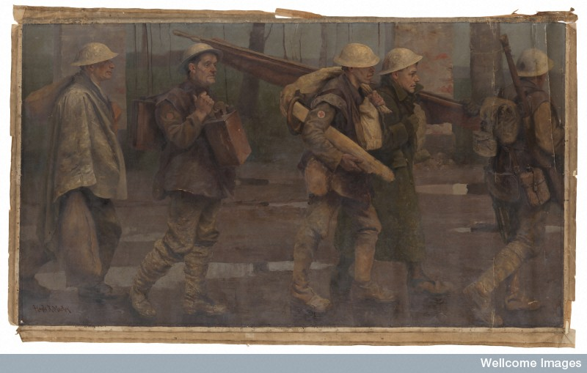
Auxiliaries bringing stretchers, splints, rations and water for the Line. Available via Wellcome Collection as CC-BY-NC-SA
Painting of a carrying party moving up the line, presumably to a Regimental Aid Post or Dressing Station. Water is carried in a 2 gallon petrol tin (still with its red warning paint) by the man second from left, a stretcher is slung over the shoulder of the man standing second from right, and other men carry supplies in sand bags. The infantryman on the far right is perhaps acting as a guide. This painting conveys the difficulty of keeping aid posts supplied and medical equipment clean in the forward areas.

Slide 8
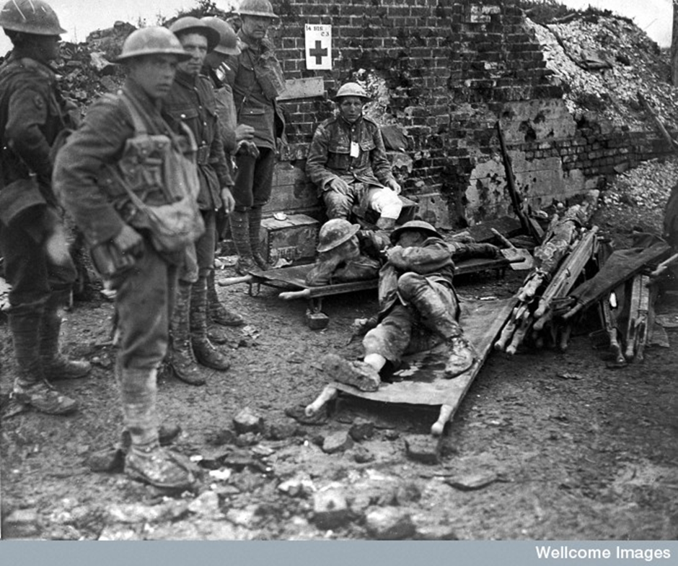
Regimental Aid Post. Available via Wellcome Collection as CC-BY-NC-SA
The Regimental Aid Post was situated just behind the front line, often in dug outs or cellars in the rear trench system, and was the first stage in the evacuation of the wounded. Aid posts had no capacity to house patients, and were equipped to provide emergency first aid only, either returning men to the front immediately or evacuating more serious casualties to Advanced Dressing Stations in the rear. Men were brought in by stretchers or made their own way by walking; given the devastation immediately behind the lines, this is also how they had to reach the second line of treatment centres. Note the bloodstains on the stretcher, which seem to have been made by a previous patient.

Slide 9
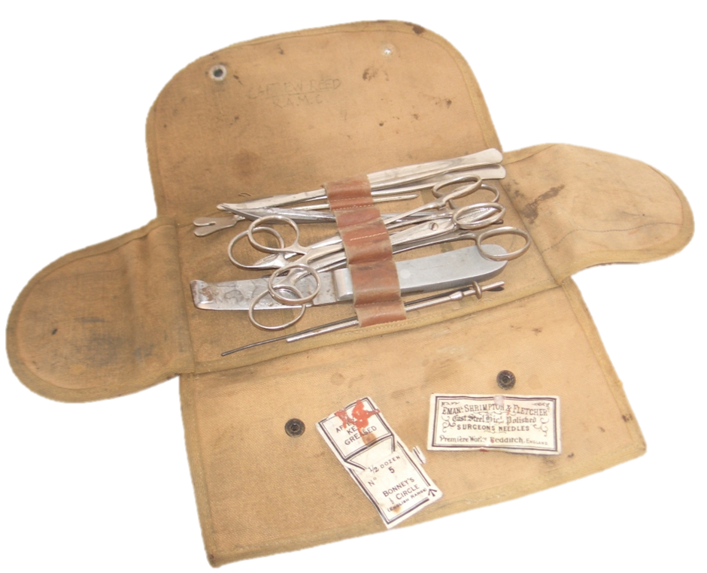
Medical Officer’s Surgical Implements. Marshall collection, available via World War One Centenary OER Project as CC BY-NC-SA
Basic set of surgical implements for emergency trauma procedures (including retractor, arterial clamps, scalpels and probes) carried by Captain Ernest William Reed M.B., West Lancashire Field Ambulance, Royal Army Medical Corps. With two small paper packets containing surgical needles. Not much more could be expected until the patient reached a Casualty Clearing Station.

Slide 10
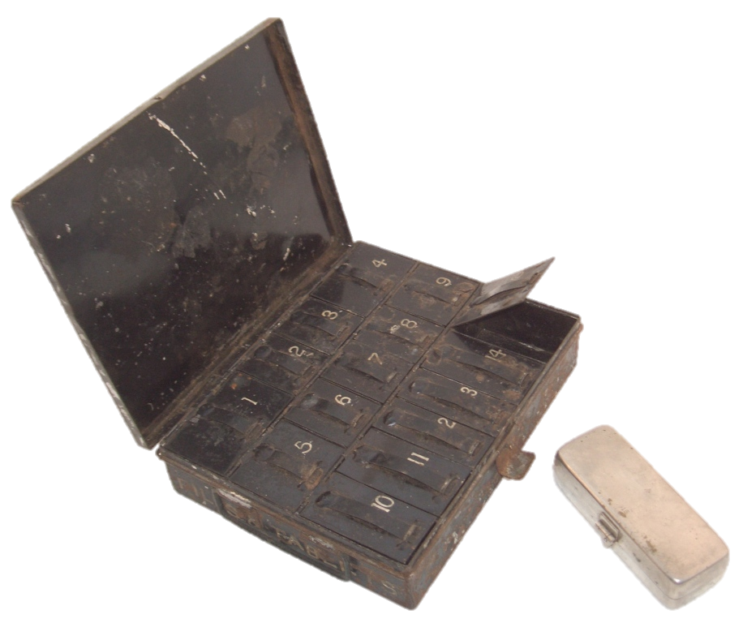
Pills and Tablets Tin with Syringe Case. Marshall collection, available via World War One Centenary OER Project as CC BY-NC-SA
Medical Officers attached to fighting units carried very few drugs. Pictured is the Tablet Tin issued to every Regimental Aid Post, part of the contents of the Field Medical Companion. Each drug was given a number by the medical authorities and kept in the corresponding compartment; descriptive labels were avoided to discourage theft and self-medication by the troops. No. 9 contained cough medication, No. 9 compound of rhubarb, used as a laxative (the bingo call ‘No. 9, Doctor’s Orders’, originates from this army practice), No. 12 opium powder, etc. To the right is pictured a hypodermic syringe in its case, used for the administration of morphine and other drugs. The idea of single-use disposable equipment (removing the need for elaborate sterilization procedures) arose during the war, but was of limited application with the materials then available.

Slide 11
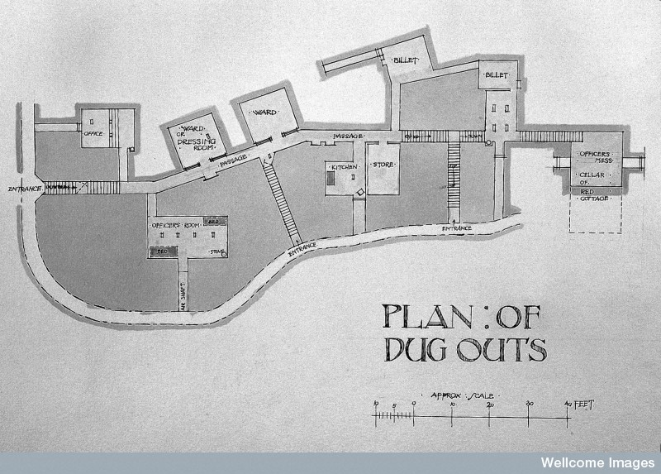
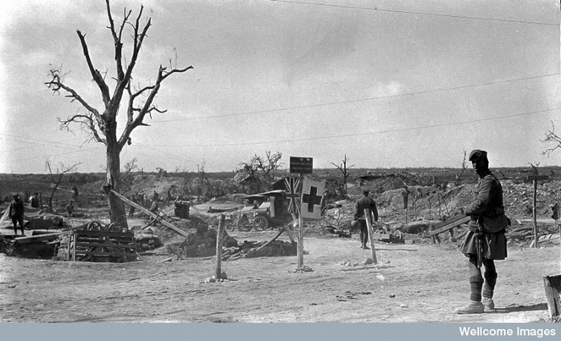
Left: Advanced Dressing Station, Red Cottage, Fricourt, plan of dug outs 1916 – 1917. Available via Wellcome Collection as CC-BY-NC-SA
Right: No. 69 F.A. [Field Ambulance] at Red Cottage, Fricourt. Available via Wellcome Collection as CC-BY-NC-SA
An Advanced Dressing Station on the Somme: plan of dug outs and view above ground. Advanced Dressing Stations were manned by Field Ambulances and provided limited surgical facilities for emergency cases. To treat the wounded as quickly as possible they had to be close to the front line, often within range of the enemy’s field artillery. As can be seen from the devastation in the photograph on the right, this dressing station has had to be housed in dug outs. These provide barely enough shelter for the staff of the Field Ambulance; in times of heavy fighting, the wounded will have had to be left in the open on stretchers.

Slide 12
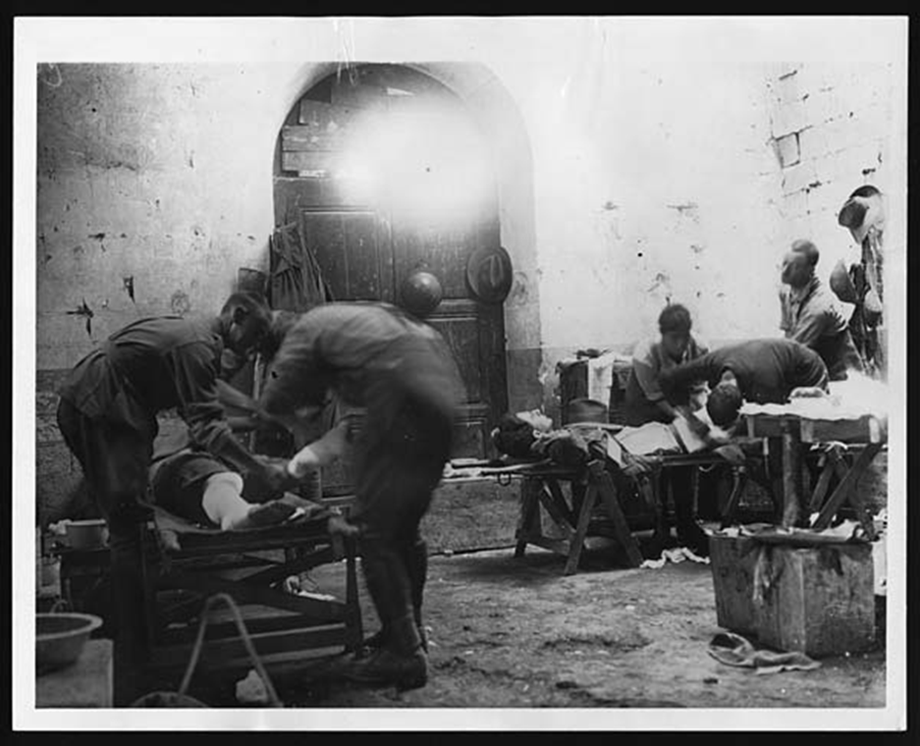
Original caption: Dressing wounds of an Anzac man. Available via the National Library of Scotland as CC-BY-NC-SA
Men of the Australian and New Zealand Army Corps being treated at a Dressing Station, illustrating the limited extent of the medical facilities available near the front line. Note the graffiti (including several British cap badges) on the rear wall.

Slide 13
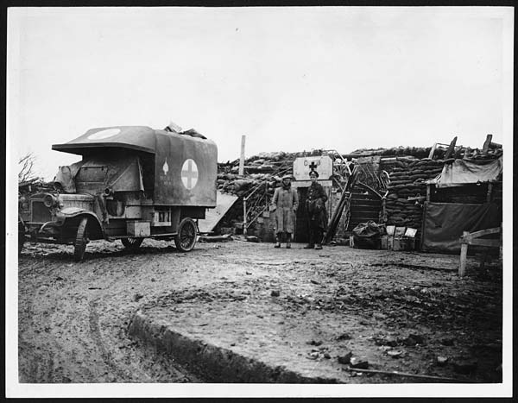
Original Caption: An Advanced Dressing Station. Available via the National Library of Scotland as CC-BY-NC-SA
Ambulance parked outside an Advanced Dressing Station waiting to evacuate wounded to a Casualty Clearing Station further in the rear The dressing station has been set up in the cellar of a ruined house; note the stretchers and 2 gallon petrol tins, now used for drinking water, piled outside the door. The ambulance driver (standing left) and a gunner of the Royal Artillery look on.

Slide 14
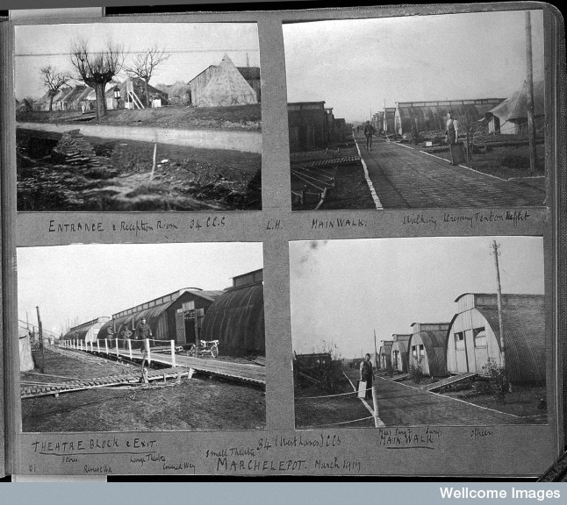
Casualty Clearing Station, RAMC Territorial Force. Available via Wellcome Collection as CC-BY-NC-SA
The Casualty Clearing Stations provided the first dedicated surgical facilities in the chain of evacuation, and were able to provide beds for men who could be expected to recover and return to their units within a few days. More serious cases were sent to hospitals in England or the Base Area. They were usually sited 5-10 miles behind the lines and close to canals or railway lines to facilitate mass onward transportation. Casualty Clearing Stations often worked in threes, one taking the sick, two working in relay taking the wounded. Such centres were the farthest forward that nurses operated, though still within range of enemy air raids.
From photograph album of 34 (1/1) West Lancashire Casualty Clearing Station. Photographs taken at Marchelepot, March 1917.

Slide 15
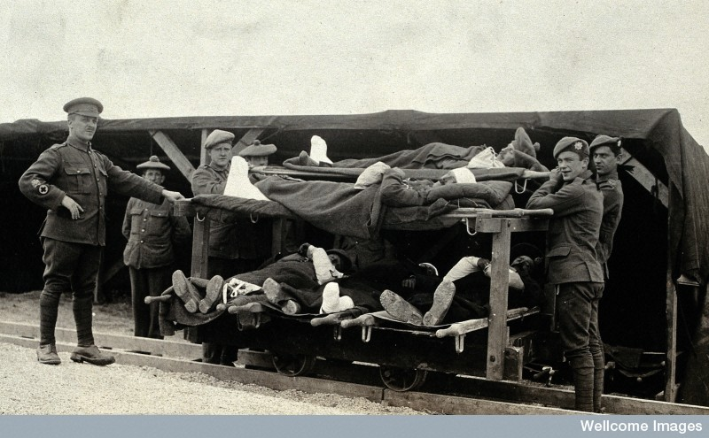
Wounded soldiers on a trolley being taken from the Casualty Clearing Station to an ambulance train. Available via Wellcome Collection as CC-BY-NC-SA
Moving the wounded from the front proved to be a considerable logistical problem, as supplies for the fighting men had to take precedence. Roads were frequently rendered impassable to motor ambulances by gun fire or traffic, and so dedicated light railways were often laid between treatment centres further in the rear. Note here the employment of wooden planks as tracks, and the apparent absence of suspension for the passengers.
Another photograph in this series is captioned: ‘July 1916 | Evacuating wounded by an improvised trolley line from No. 3 C.C.S. [Casualty Clearing Station] Pushvillers to an Amb. [Ambulance] Train’.

Slide 16
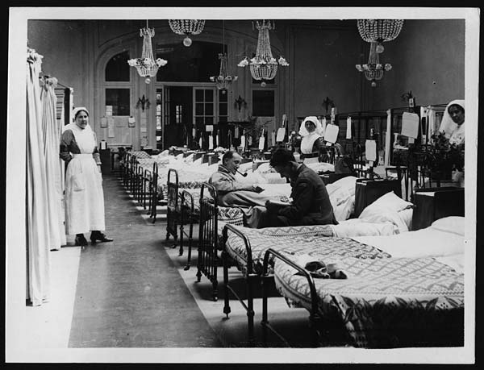
Original caption: OFFICIAL PHOTOGRAPHS TAKEN ON THE BRITISH WESTERN FRONT IN FRANCE - SCENE IN A WARD OF SA HOSPITAL. Available via the National Library of Scotland as CC-BY-NC-SA
Scene of a ward in the No. 1 South African General Hospital, opened in July 1916 in a chateaux on the outskirts of Abbeville. Base Hospitals such as this provided facilities for longer-term treatment and convalescence; many had to stay open late into 1919 to care for the sick and wounded.

Slide 17
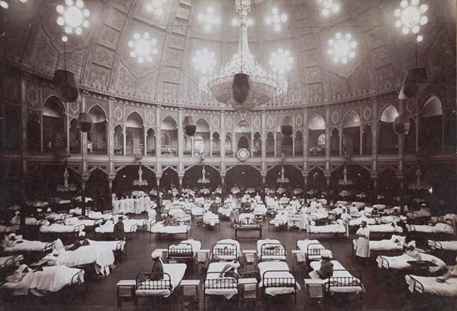
The Royal Pavilion, 1914-15. Available via Wellcome Collection as CC-BY-NC-SA
In order to accommodate the massive numbers of casualties, numerous buildings in Britain were adapted into military hospitals, from schools to country houses. One of the most architecturally elaborate hospitals was the Royal Pavilion in Brighton, which opened its doors to hundreds of sick and wounded Indian troops returning from the battlefields in France. The Pavilion, built to resemble an Indian palace, was chosen to convince opinion in India that their troops were being well cared for by the British authorities. When Indian troops were moved to the Middle Eastern theatre in 1916, the hospital was closed.

Slide 18
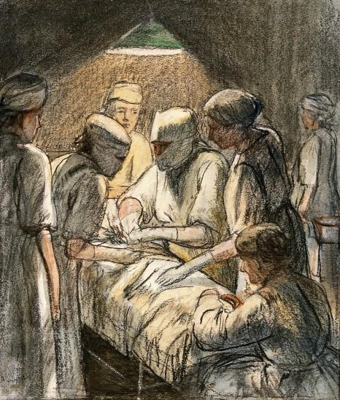
An operation for appendicitis at the Military Hospital, Endell Street, London. Available via Wellcome Collection as CC-BY-NC-SA
Although wounds and diseases associated with the front line absorbed much of the medical services’ time and resources, men continued to succumb to peace-time ailments such as appendicitis, and still had to be cared for by the authorities.
The Military Hospital in Endell Street, London was no ordinary hospital: it was staffed entirely by women. Founded in 1915 by two suffragettes, Dr Louisa Garrett Anderson and Dr Flora Murray, the hospital flourished throughout the war and only closed in December 1919 after its work came to an end. During these four years its staff proved what many had doubted - that women could manage the medical and administrative aspects of a hospital just as well as men.

Slide 19
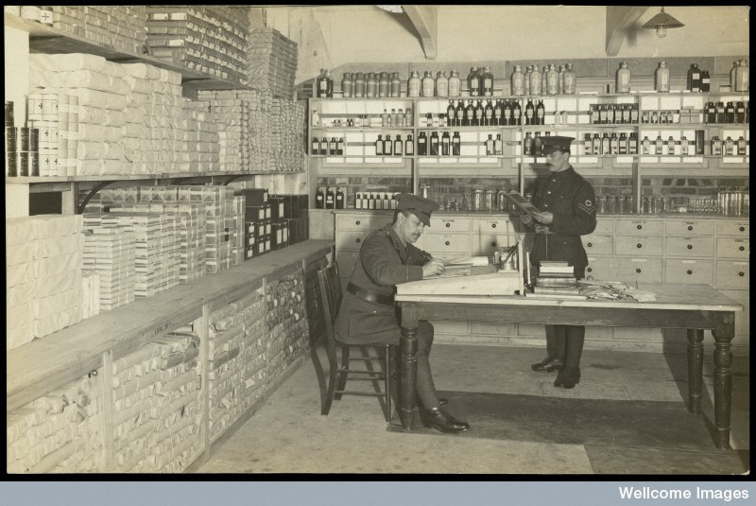
Hospital store. Available via Wellcome Collection as CC-BY-NC-SA
Royal Army Medical Corps corporal (standing) and officer (seated) in one of the stores of the King George Hospital for wounded soldiers, Stamford Street, London. The King George Hospital was installed in a commandeered warehouse and finally accepted its first patients in May 1915, after strikes had delayed its opening. With 1650 beds (later 1850), it was reputed to be the largest hospital in the United Kingdom.

Slide 20
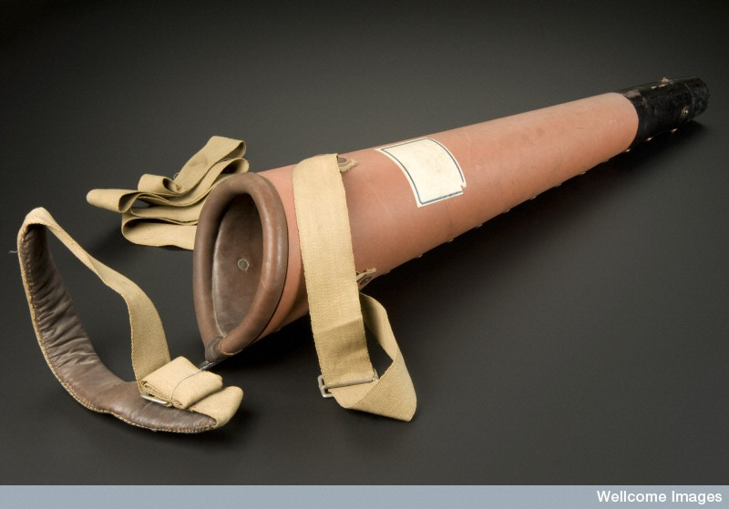
Artificial leg. Available via Wellcome Collection as CC-BY-NC-SA.
Prosthetic legs such as this one were known as pylons and they were issued to servicemen who had recently lost a leg to get them used to the idea and feel of an artificial leg. They would be worn for a short period before a proper artificial limb was fitted. Made from fibre with leather padding, the leg was issued by a Red Cross provisional limb depot in Stretford, Manchester, England.

